Slide 1
E-Commerce Analysis
(Using SQL)
-Arshiya Khatoon

Slide 2
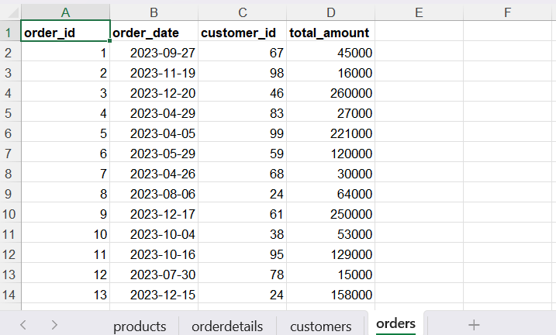
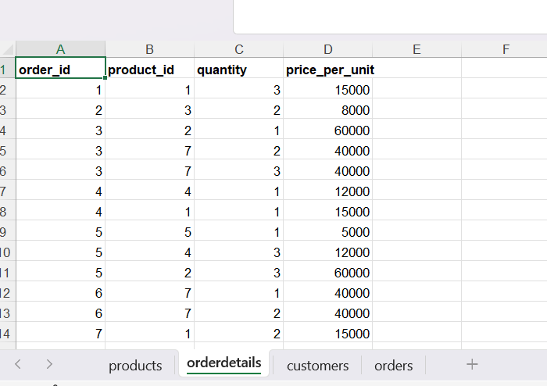
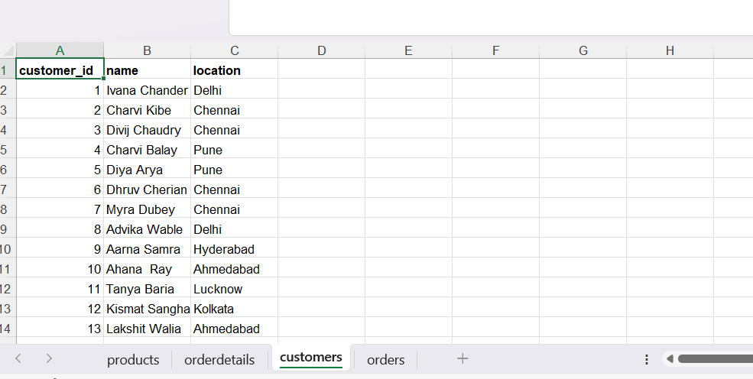
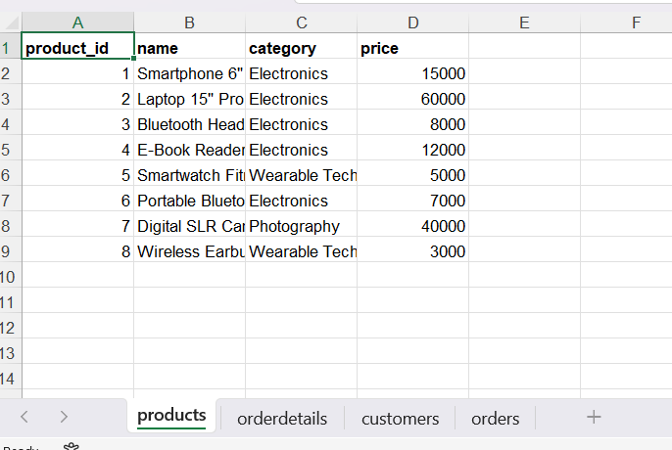
In this project, I worked with an E-commerce company’s transactional data to analyze meaningful business insights using SQL.
By analyzing customers, products, and orders, I explored buying behavior, product performance, and sales trends through joins, aggregations, and date-based analysis.
Here are the four tables used in this project:
Orders – Stores order-level transaction details, showing when purchases happen and how much customers spend.
OrderDetails – Provides an item-wise breakdown of each order, detailing which products are purchased and in what quantity.
Customers – Contains customer information and location data, helping identify who the customers are and where they come from.
Products – Holds product details including category and price, explaining what is being sold and at what cost.

Slide 3
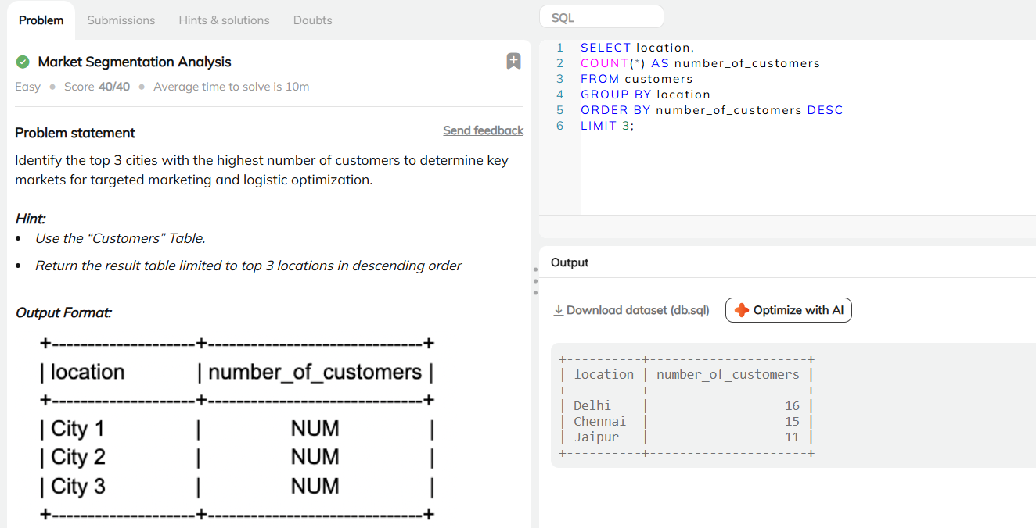
Market Segmentation by Location
To identify cities with the highest customer presence, the Customers table is grouped by location and customer counts are calculated. The results are sorted in descending order and limited to the top three cities. This helps the business prioritize key markets for marketing and logistics.
The output highlights Delhi as the leading city, followed by Chennai and Jaipur.

Slide 4
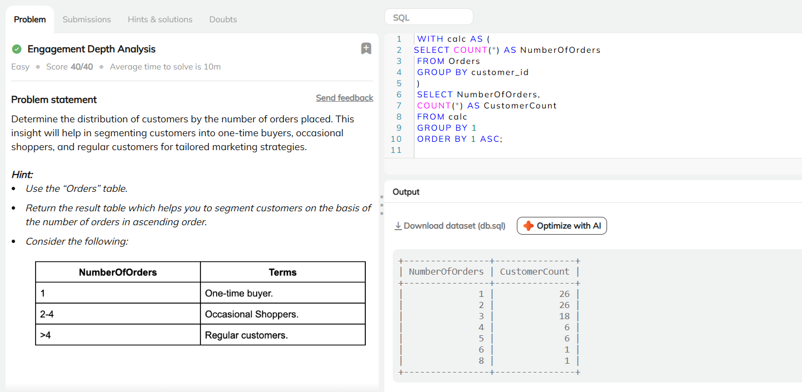
Customer Engagement Analysis
To determine how frequently customers place orders, the number of orders per customer is calculated using the Orders table. Customers are grouped based on their order count, and the distribution is sorted in ascending order to understand engagement levels.
The results help segment customers into one-time buyers, occasional shoppers, and regular customers, enabling more targeted marketing and retention strategies.
The output shows that most customers place one or two orders, while a smaller group places multiple orders, indicating a core base of regular customers.

Slide 5
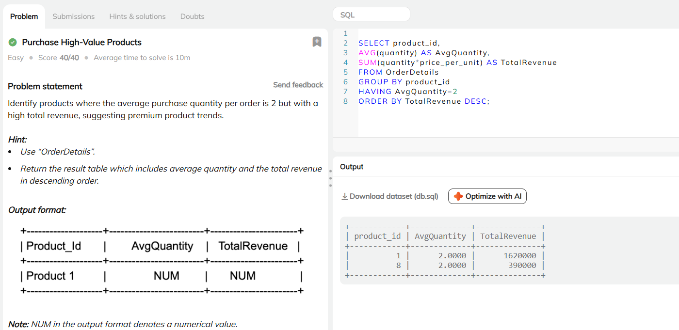
Identification of High-Value Products with Low Purchase Volume
To identify products that are typically purchased in small quantities (an average of two units per order) but still generate high revenue, the OrderDetails table is analyzed. The data is grouped by product to calculate the average quantity per order and the total revenue, helping highlight premium or high-value products.
The results are sorted in descending order of total revenue to easily identify top-performing items.
The output displays products with an average purchase quantity of two that contribute the highest total revenue, indicating strong revenue performance despite low purchase volume.

Slide 6
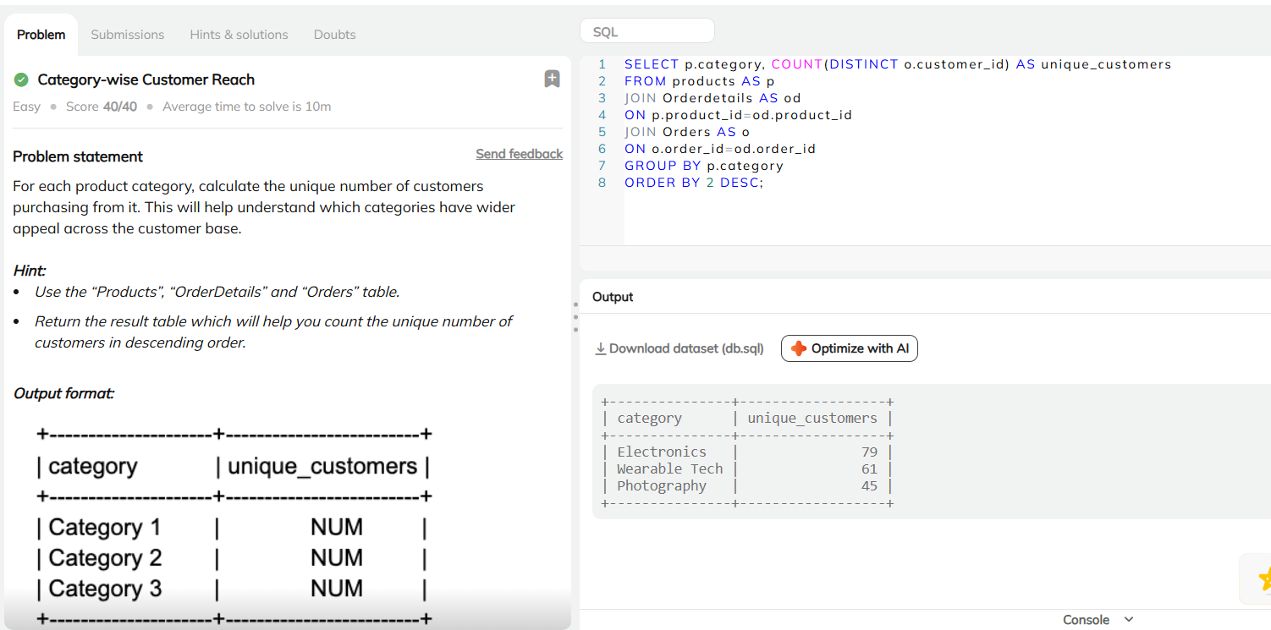
Unique Customers per Category
To calculate the number of unique customers for each product category, the Products, OrderDetails, and Orders tables are joined. The data is grouped by category and sorted in descending order.
The output shows that Electronics has the widest customer reach, followed by Wearable Tech and Photography.

Slide 7
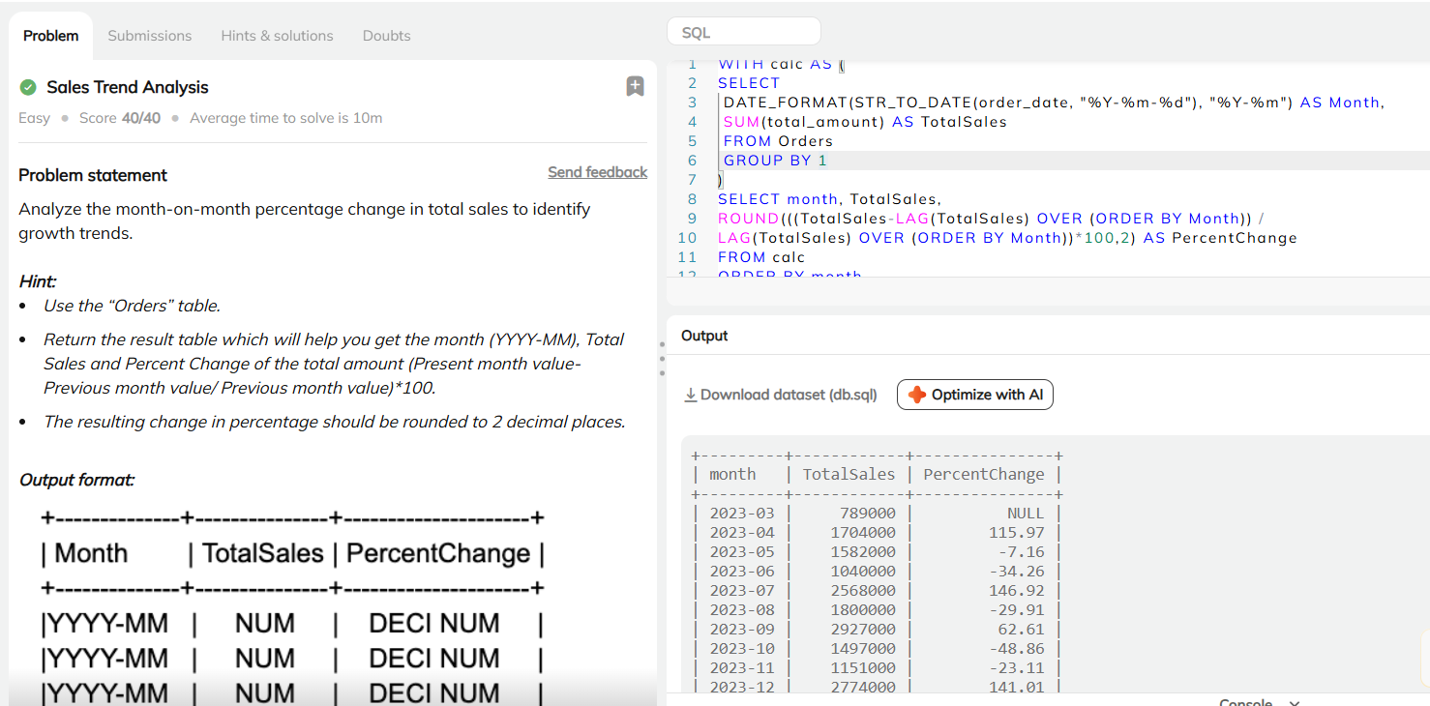
Monthly Sales Trend Analysis
To analyze monthly sales performance, the Orders table is used to aggregate total sales by month by converting order dates into a YYYY-MM format. A window function (LAG) is then applied to compare each month’s sales with the previous month and calculate the month-on-month percentage change using the formula: ((current−previous)/previous)*100.
The results are rounded to two decimal places and ordered chronologically.
The output shows irregular month-on-month sales, with spikes in certain months and declines in others, indicating seasonal and volatile revenue patterns.

Slide 8
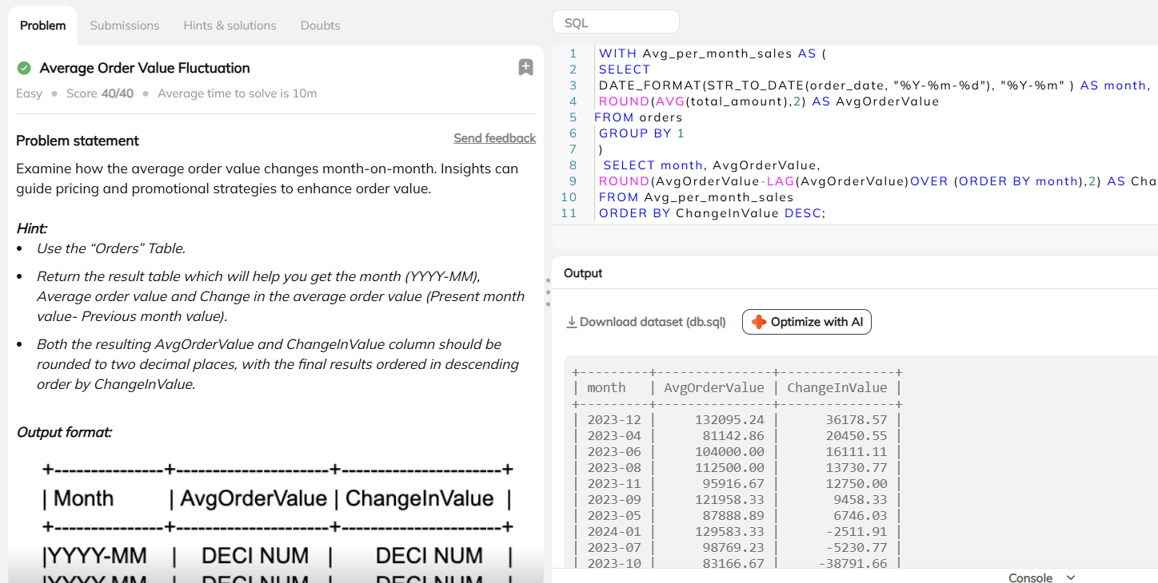
Average Order Value Trend Analysis
To analyze changes in average order value per month, the Orders table is used to calculate the monthly average order value by converting order dates into a YYYY–MM format. A window function (LAG) compares each month’s rounded average with the previous month to calculate the change in value. Result are then rounded to two decimal places and sorted in descending order of change to highlight the most significant fluctuations.
The output shows notable variations in average order value across months, with the largest increase occurring in December and some months showing declines, indicating fluctuating customer spending behavior and the impact of seasonal or promotional factors.

Slide 9
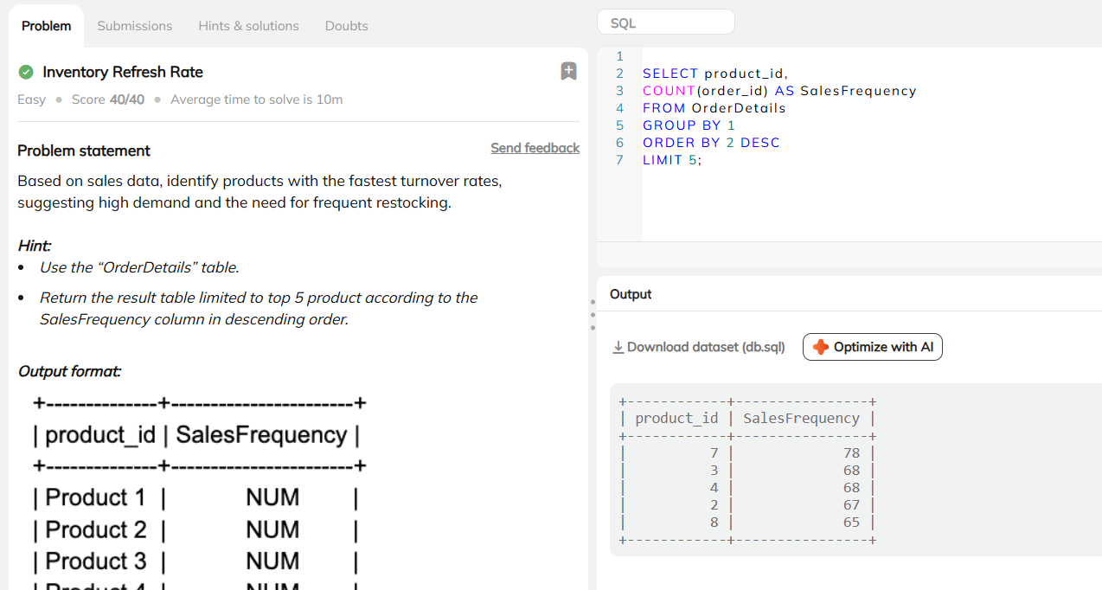
Products Requiring Frequent Restocking
To identify products with the fastest turnover rates, the OrderDetails table is used to count how many times each product appears in orders using COUNT(order_id). The data is grouped by product_id and sorted in descending order of sales frequency, with the top five products selected.
The output highlights the five most frequently ordered products, indicating high demand and rapid stock turnover. This suggests that these products require more frequent restocking to prevent inventory shortages.

Slide 10
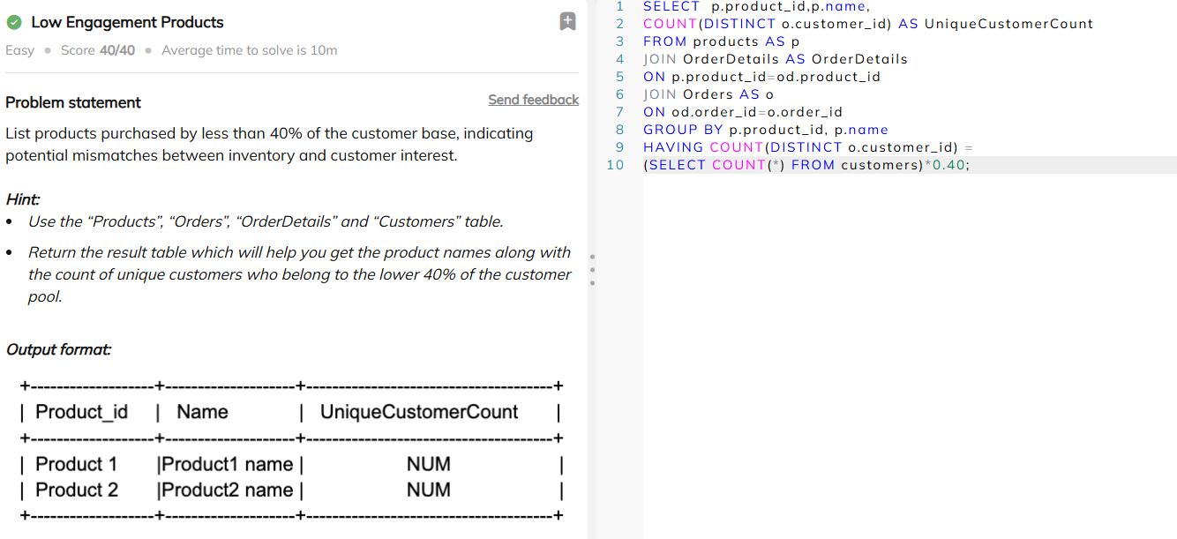
Products with Low Engagements
To identify low-engagement products, the Products, OrderDetails, Orders, and Customers tables are joined to calculate how many unique customers have purchased each product. Products are grouped by product ID and name, and a HAVING clause is used to filter those purchased by less than 40% of the total customer base.
The output highlights products with limited customer reach, indicating low engagement and a possible mismatch between inventory offerings and customer preferences. These products may require pricing changes, promotions, repositioning, or inventory rationalization to improve performance.

Slide 11
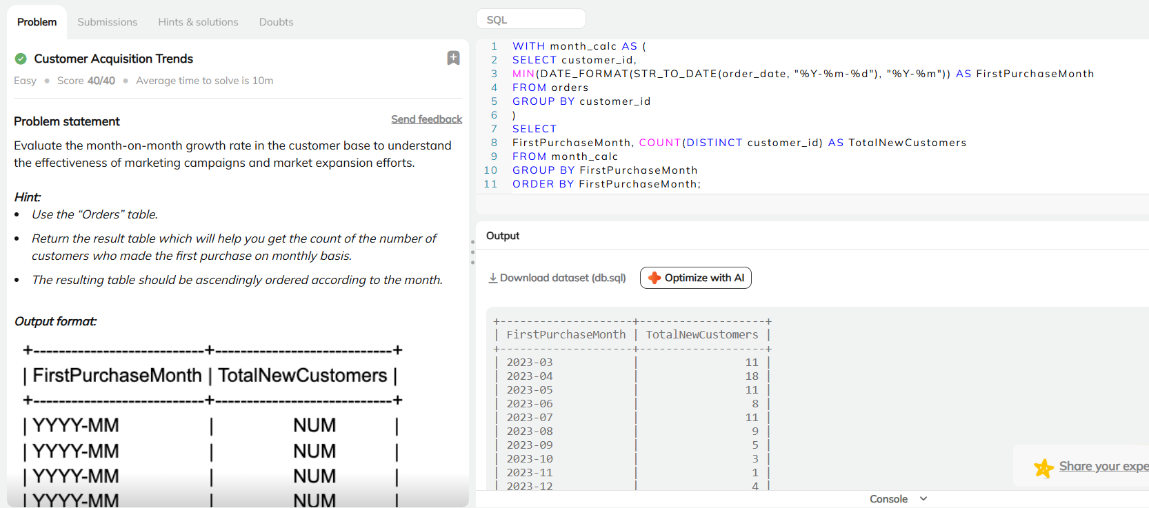
Month-wise Customer Acquisition
To analyze customer acquisition, the Orders table is used to find the month in which each customer placed their first order. Customers are grouped by this first purchase month and counted to measure how many new customers were gained each month, with results shown in chronological order.
The output highlights monthly trends in new customer growth, helping the business understand when more customers were attracted and evaluate the impact of marketing efforts and expansion strategies.

Slide 12
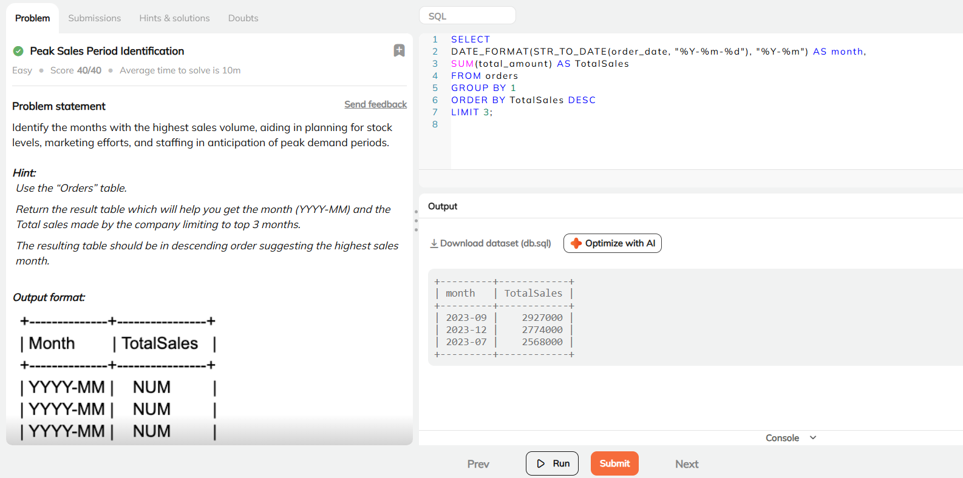
Identification of High-Revenue Months
To identify the top three peak sales periods, the Orders table is used to calculate total sales for each month by converting order dates into a YYYY–MM format and summing the total_amount. The results are grouped by month, sorted in descending order of total sales, and limited to the top three months.
The output highlights the months with the highest sales volume, indicating peak demand periods. These insights help businesses plan inventory levels, allocate staff, and optimize marketing efforts during high-revenue months

Slide 13
Key Findings & Insights
Top Customer Markets:
Delhi emerges as the largest customer hub, followed by Chennai and Jaipur, highlighting key cities for focused marketing and logistics optimization.
Customer Order Frequency:
Most customers place one or two orders, while a smaller segment places multiple orders, identifying a core group of repeat customers and opportunities for retention-focused strategies.
High-Value, Low-Volume Products:
Certain products are purchased in small quantities (average of two units per order) yet generate high total revenue, indicating premium or high-margin items that significantly contribute to sales.
Customer Reach by Category: Electronics has the widest customer base, followed by Wearable Tech and Photography, showing strong category-level demand concentration.
Monthly Sales Performance:
Sales show irregular month-on-month movement with noticeable spikes and declines, reflecting seasonal demand patterns and revenue volatility.
Low-Engagement Products:
Some products are purchased by less than 40% of customers, indicating limited reach and potential need for pricing adjustments, promotions, or inventory rationalization.
Average Order Value Trend: Average order value fluctuates across months, with a major increase in December and declines in certain periods, suggesting the influence of seasonal factors and promotional activity on customer spending.
Fast-Moving Products:
The top five most frequently ordered products demonstrate high demand and rapid turnover, requiring frequent restocking to avoid inventory shortages.
Customer Acquisition Trend:
New customer acquisition varies by month, providing insight into when marketing and expansion efforts are most effective.
Peak Sales Periods:
The top three highest-sales months represent peak demand periods, supporting better planning for inventory, staffing, and targeted marketing campaigns.

